Slide 1
The Basics
Zoe Ebling

Slide 2
Huh? What is Slack?
Slack took normal online messaging and created a collaborative system to enable a user to centralize all notifications, from sales to tech support, social media and more.
One searchable place where your team can discuss and take action all business items.

Slide 3
Basics of Slack
Direct Messages
Channels
Notification Preferences
Threads
Search
Pins

Slide 4
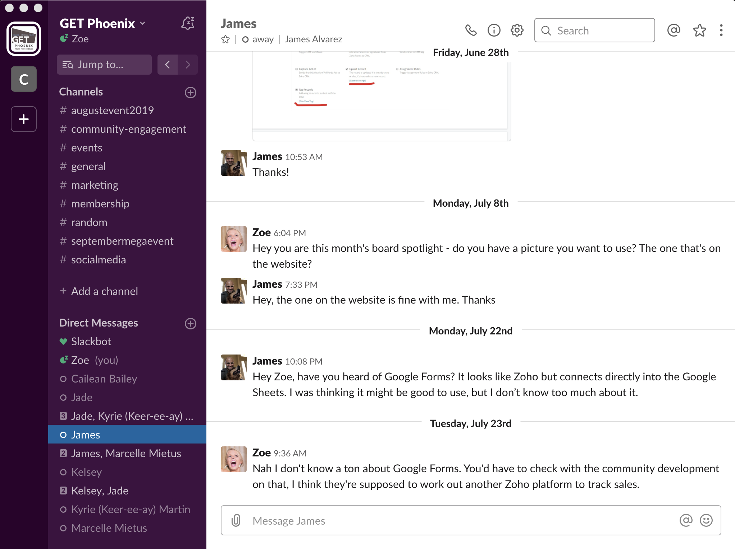
Direct Messages
Bottom left of screen called “Direct Messages” or “DMs”
Two ways to DM someone:
Click on person’s name to message them
Click the plus sign next to “Direct Messages” search for someone’s name
Similar to text messaging, sending direct email etc.
Private, no one else on Slack channel can see this
Ability to direct message multiple people – group chat

Slide 5
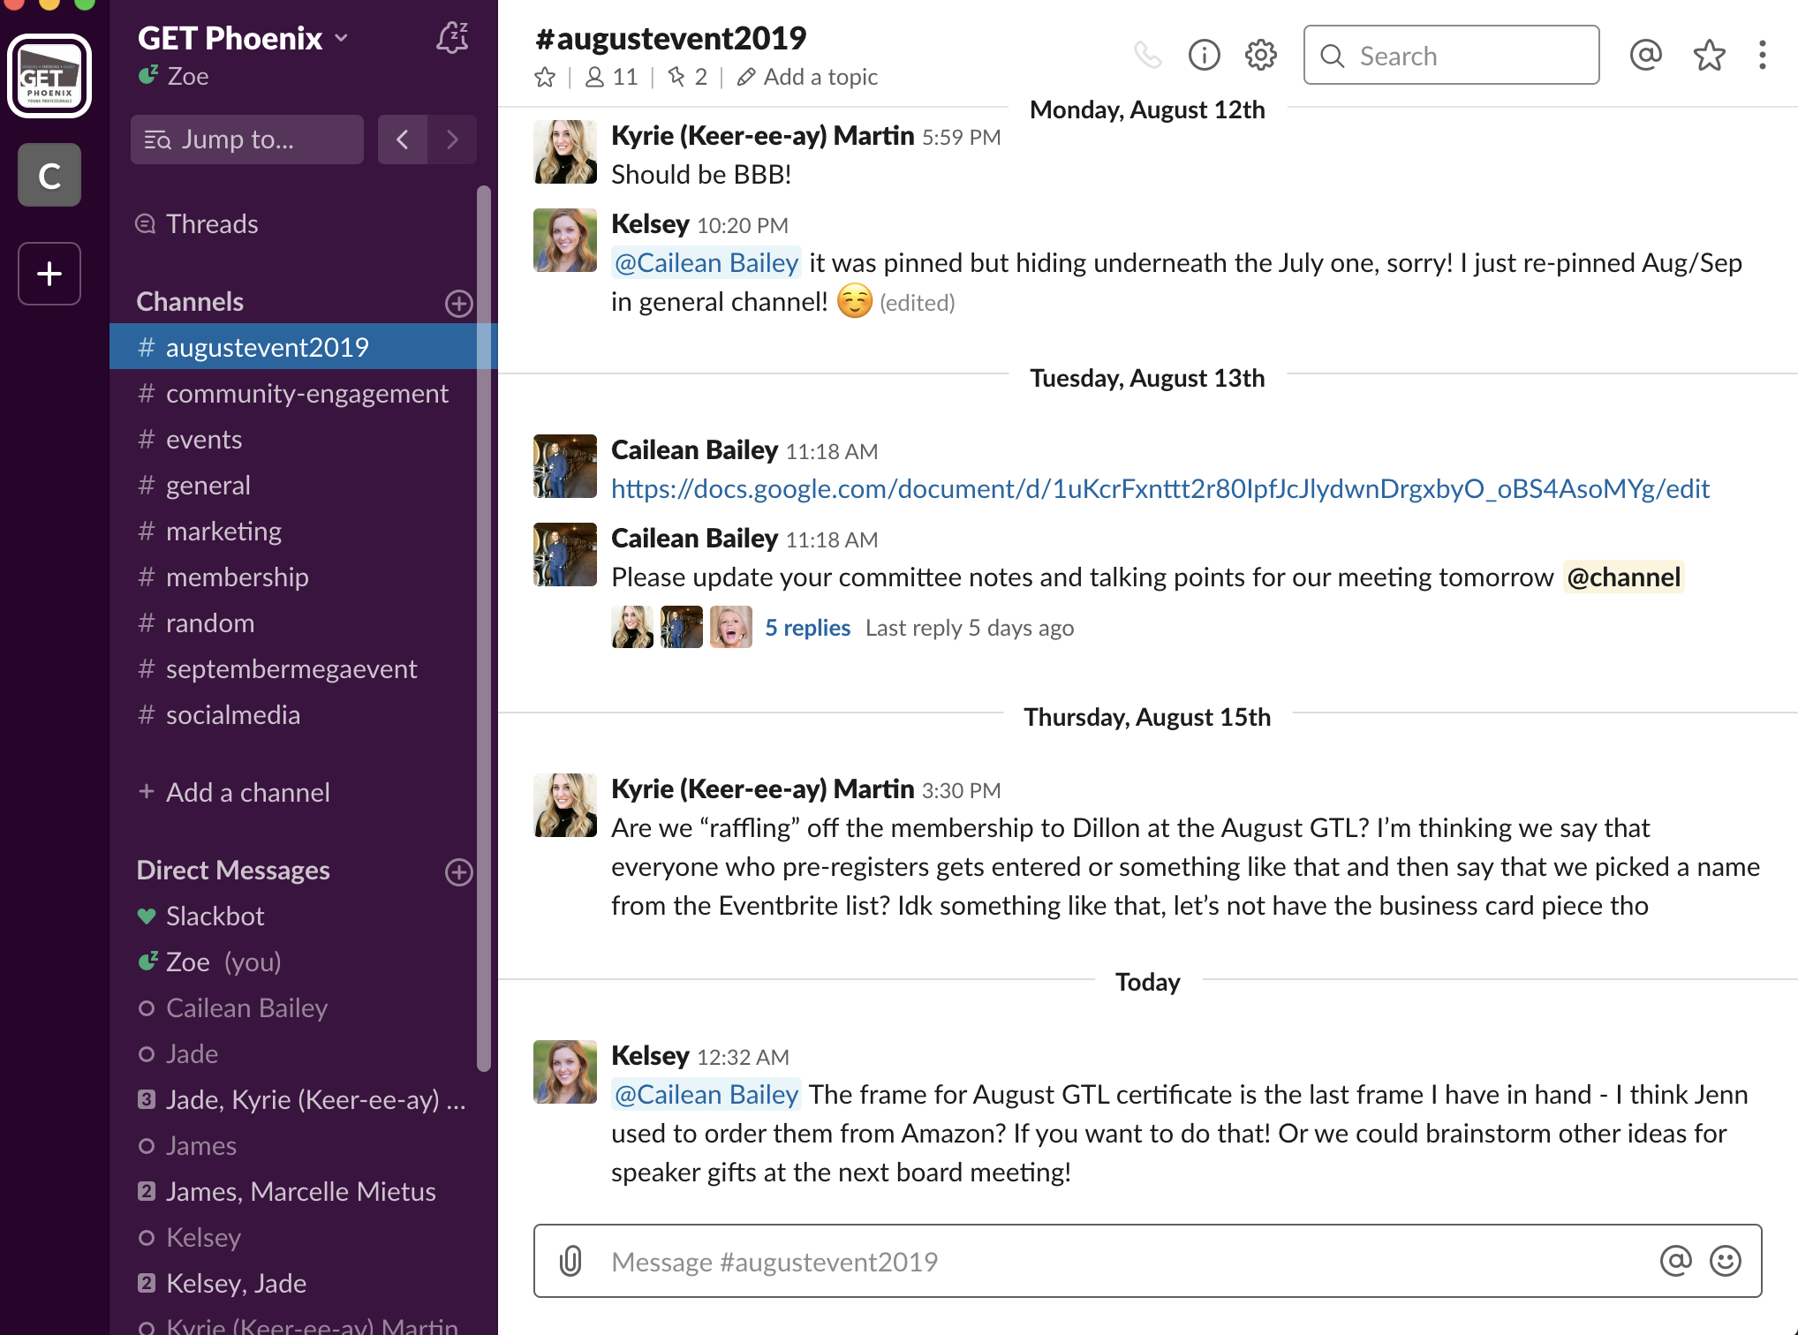
Channels
Meant for group talking
Think about a channel on TV
Ex: Food Network – focused programming around food
Same as sending ‘email blast’ within channel
Keeps thoughts and ideas about particular separated out from general forum
Have ability to update notifications for each channel
Can join or un-join channel if information doesn’t pertain to you

Slide 6
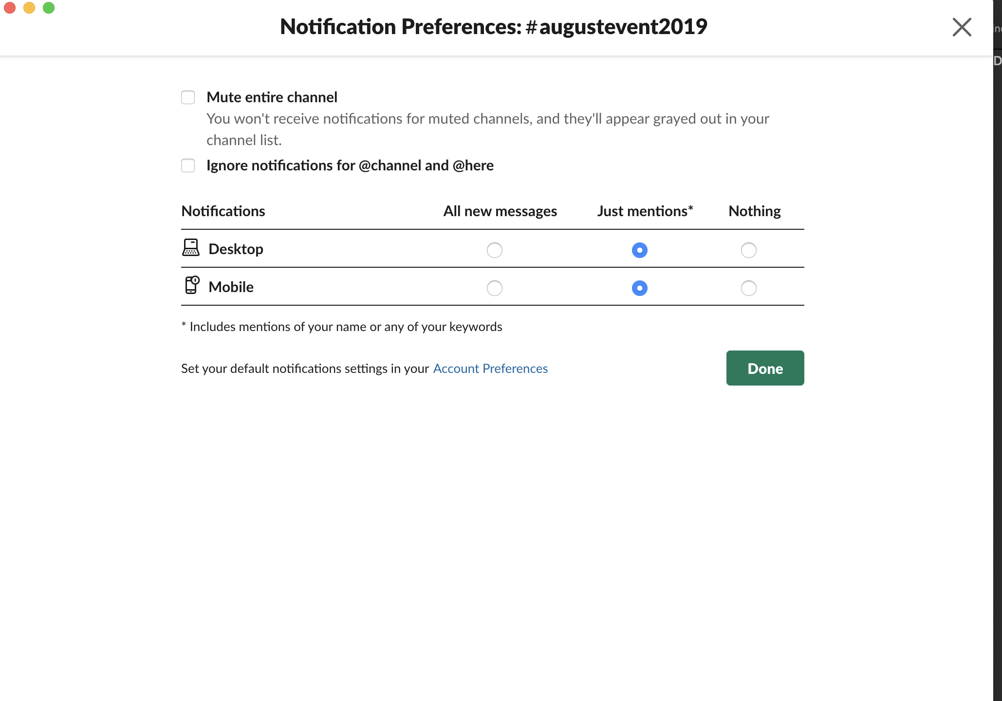
What about notifications?
Select the settings icon on the top right of any channel
Choose ”Notification Preferences”
Customize to your preferences

Slide 7
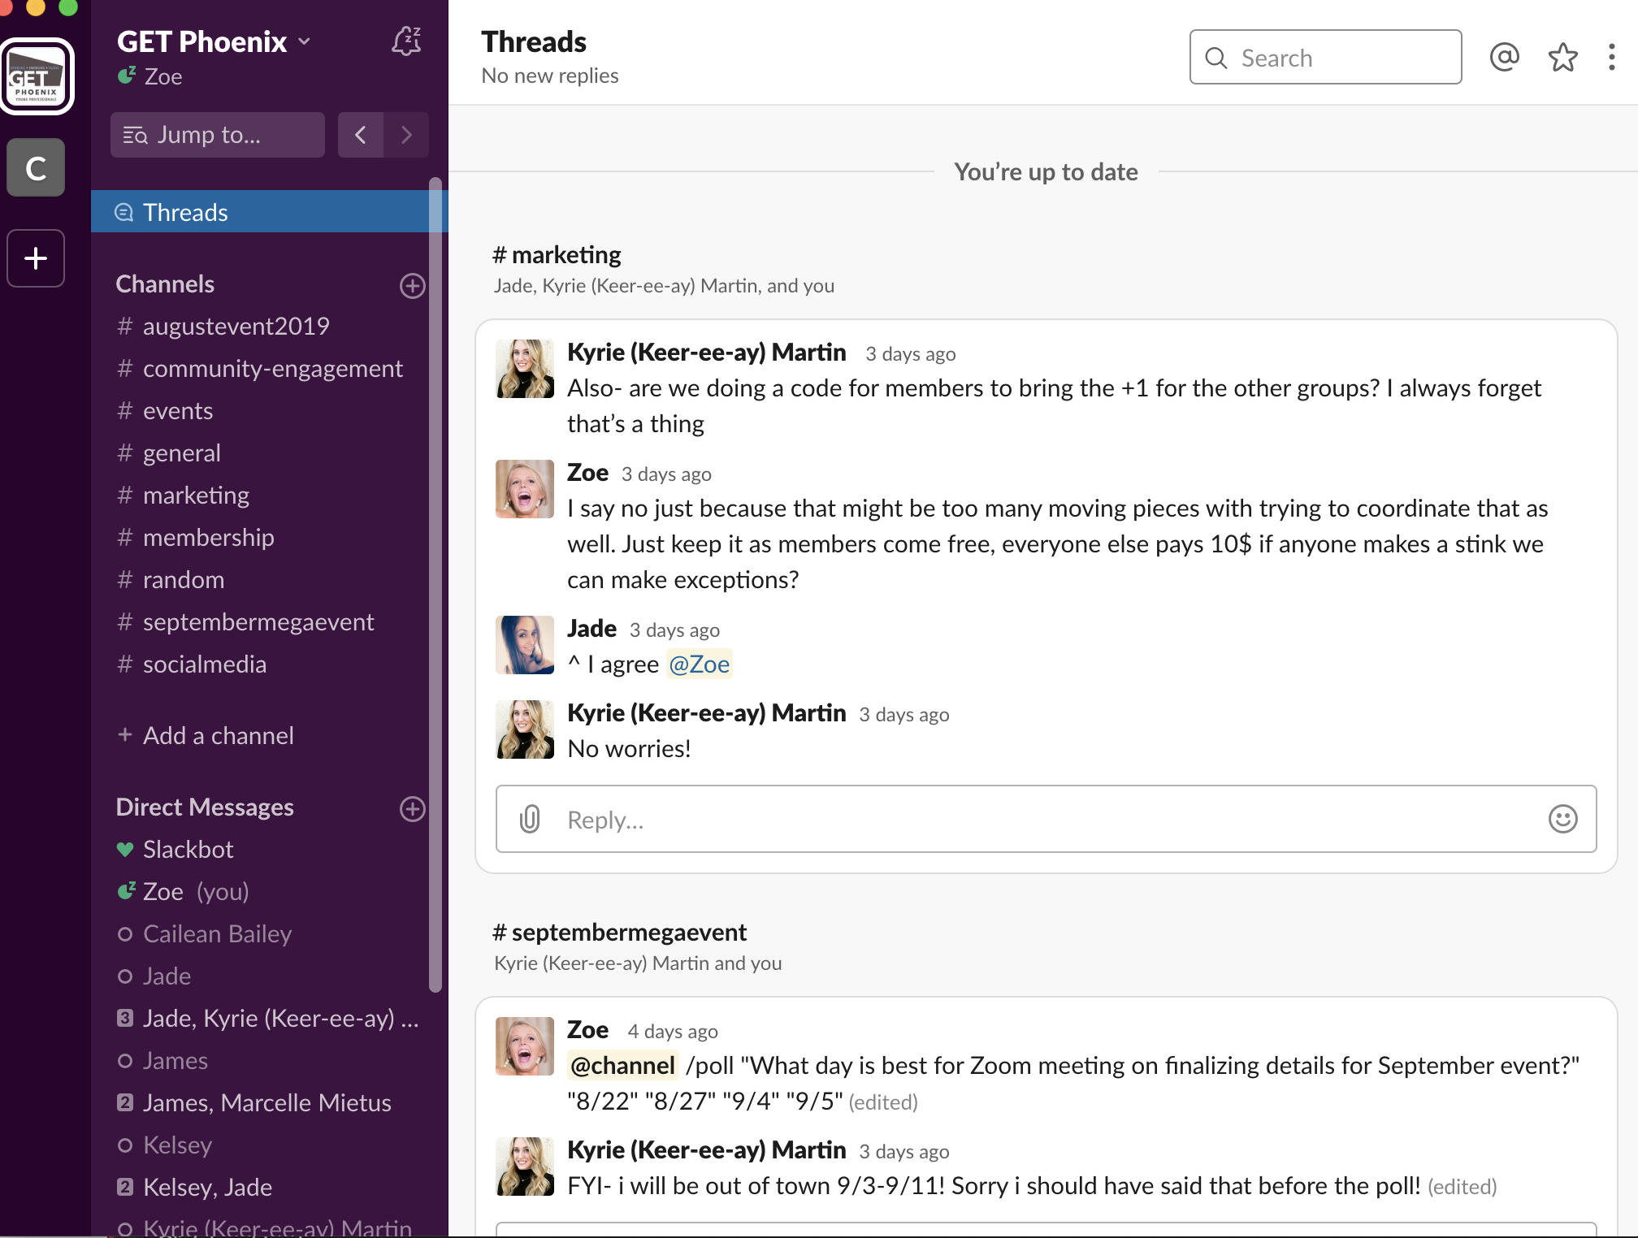
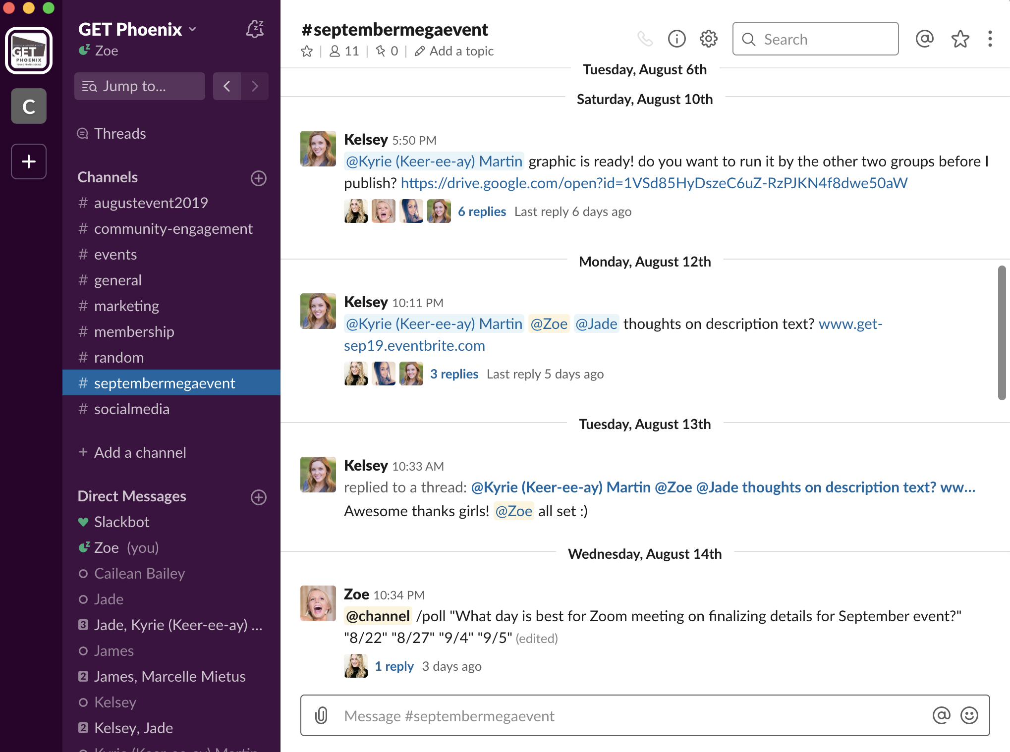
Threads
Threads keep discussions in Slack organized
They let you ask questions or give feedback on a certain idea without disrupting a conversation’s flow
Threads remain connected to its original message, only those that have contributed to it or are follow it will be notified of new replies.

Slide 8
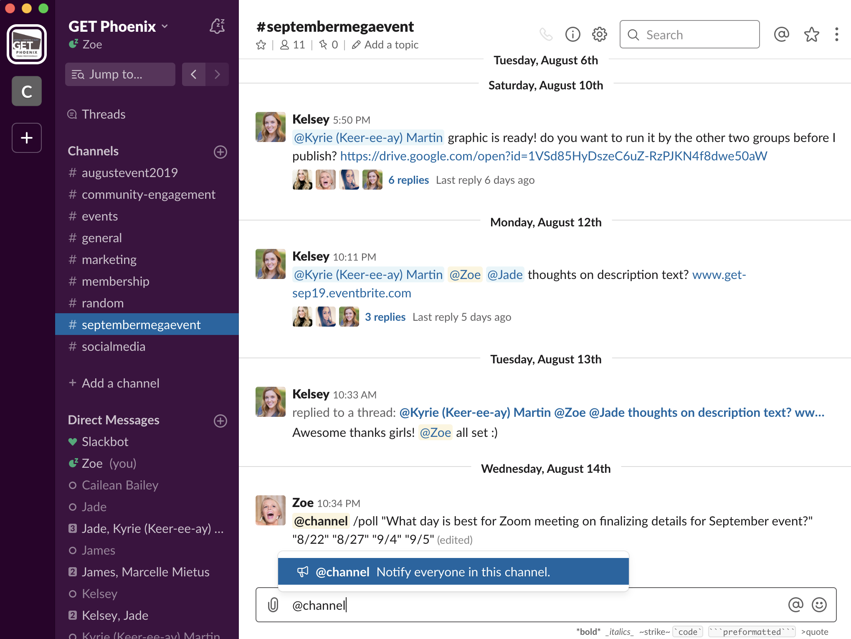
Tagging
Tag an individual person
Tag @channel to notify the entire group
If you just post a message, it might not notify the right people… unless you’re in a thread

Slide 9
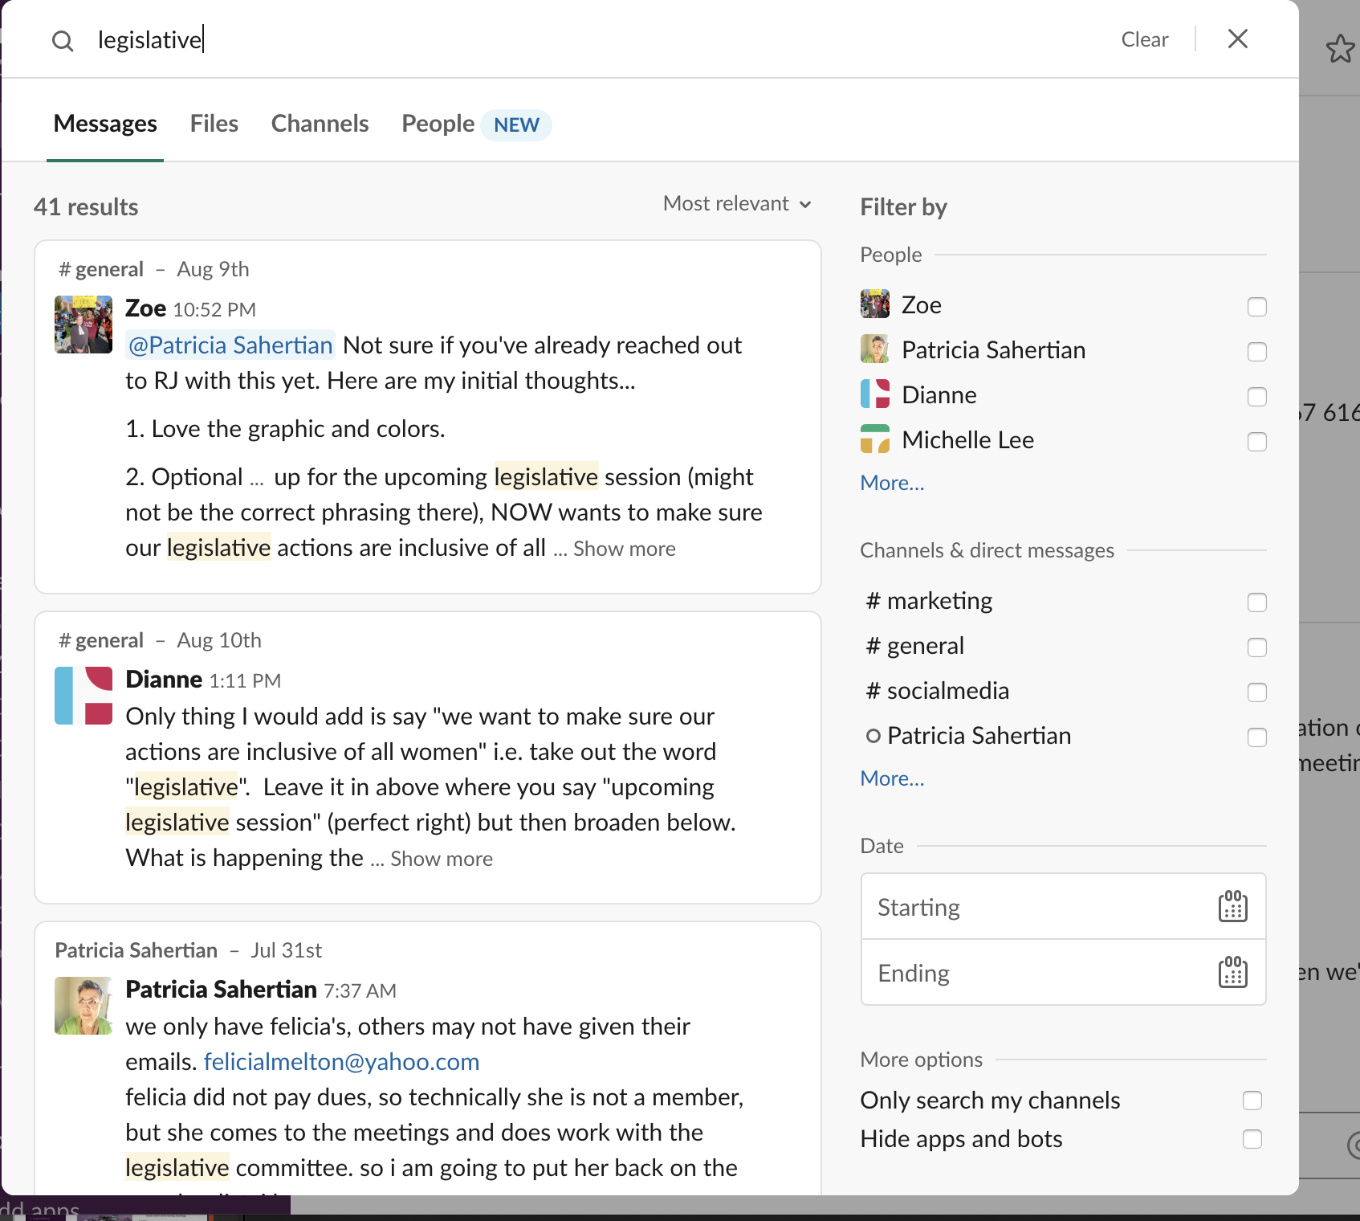
Easily Search in Channels

Slide 10
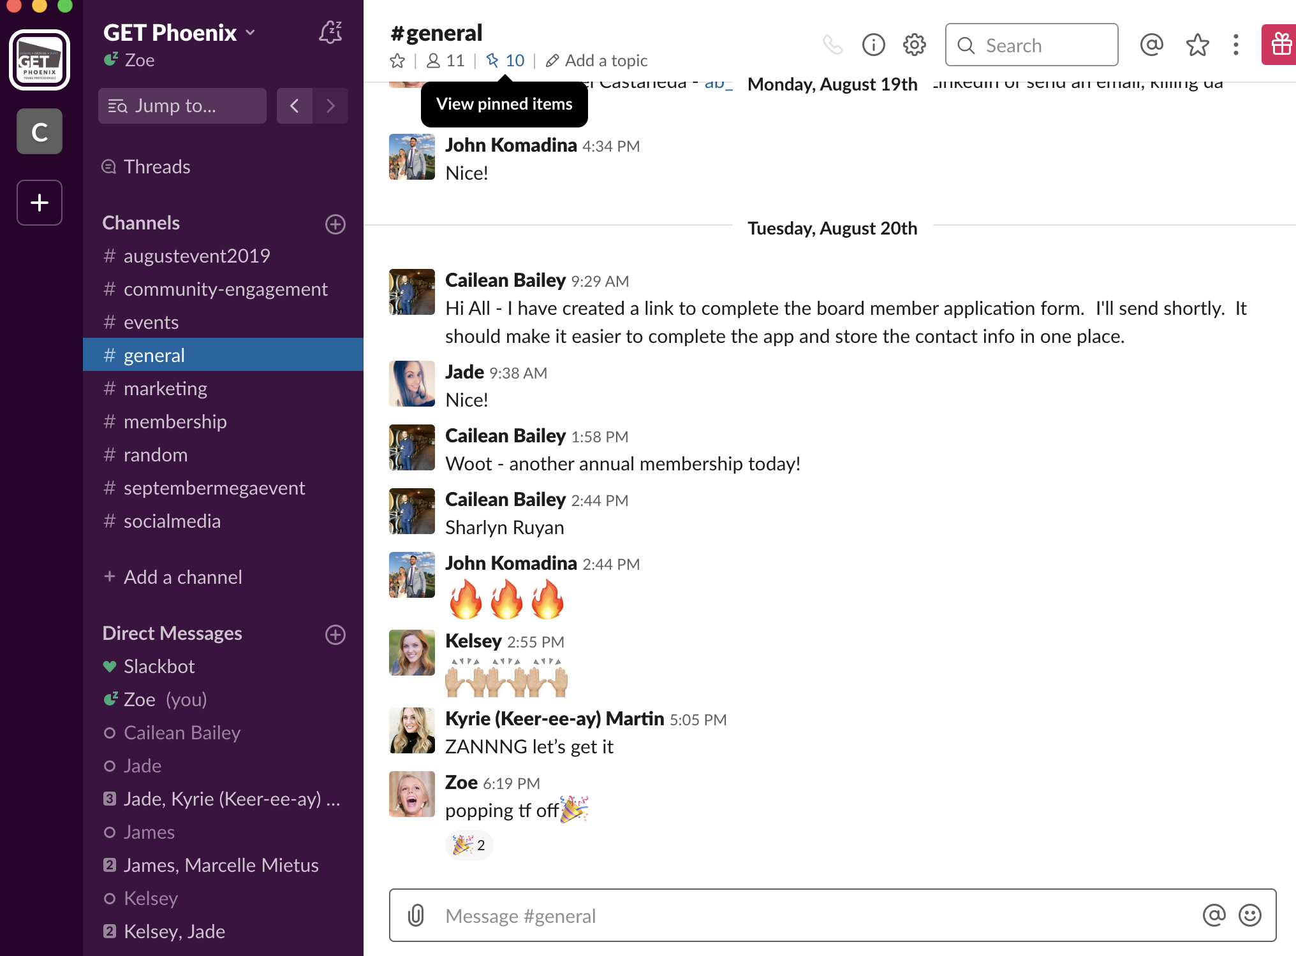
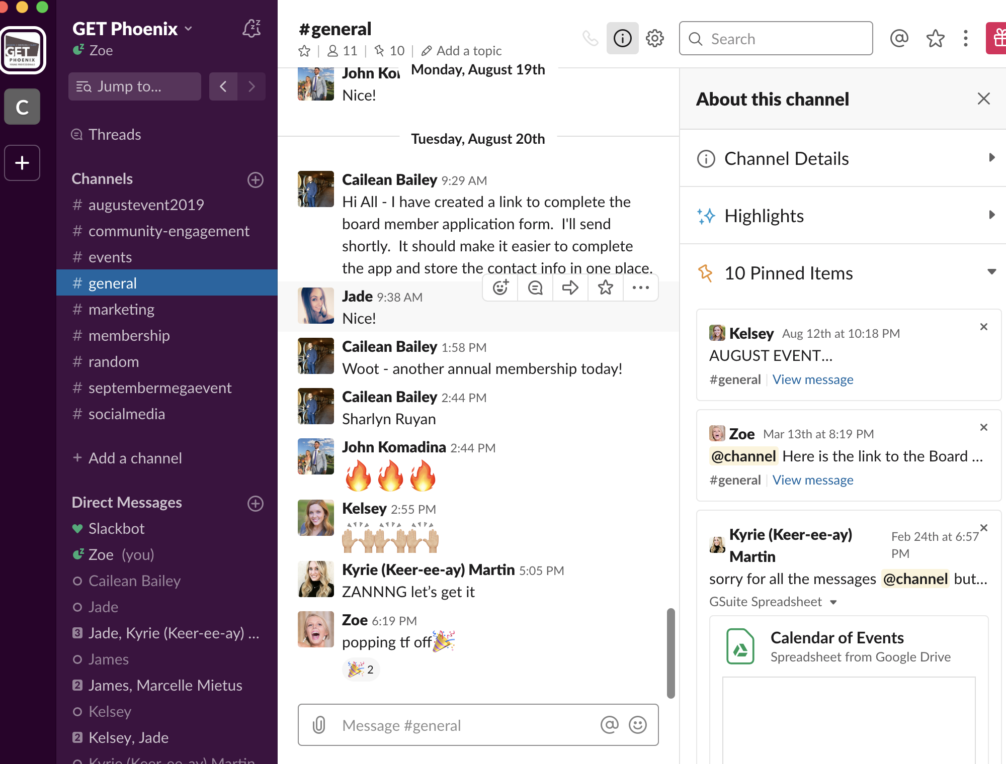
“Pin” Important Items in a Channel

Slide 11
Integrates with Google Drive

Slide 12
….and more!

